Slide 1





Car Price Prediction
Done By: Goh Rui Zhuo (22222329)

Slide 2
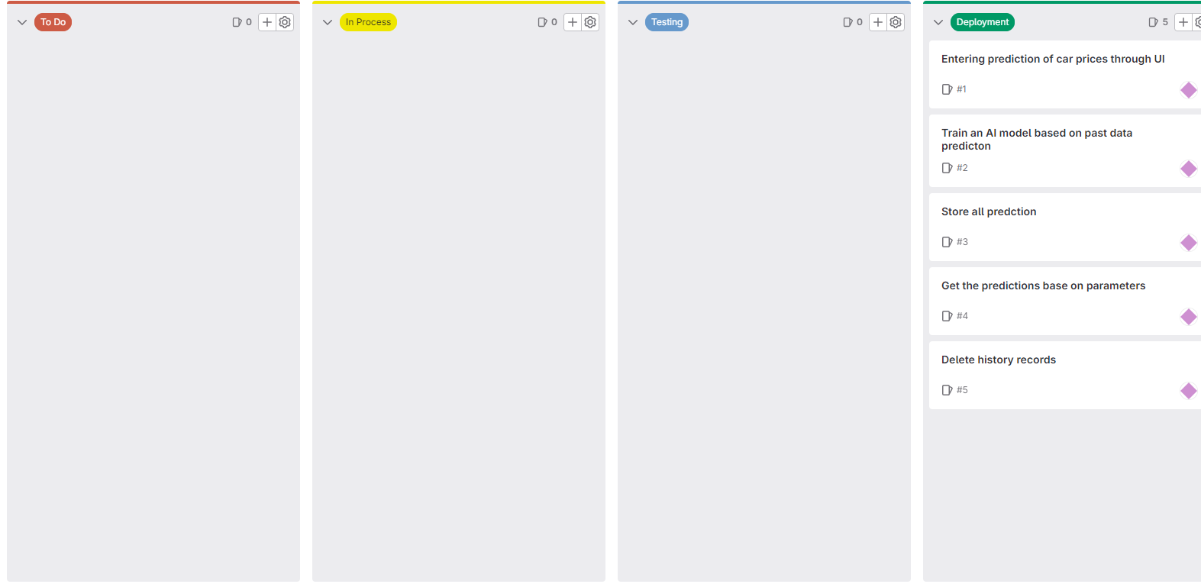
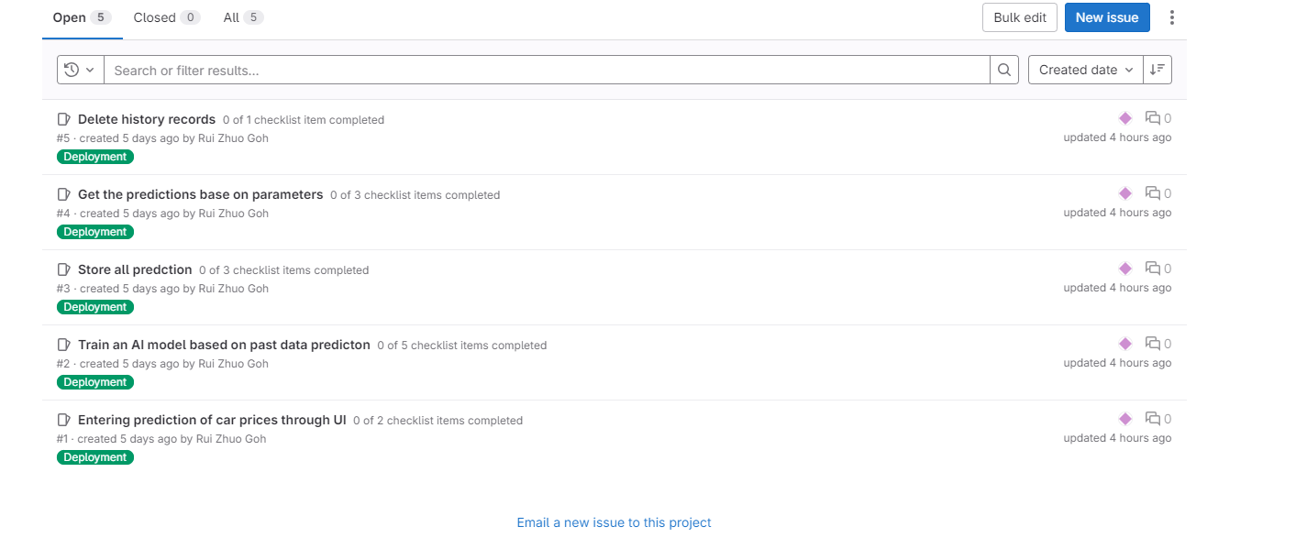
Scrum Board
Added four section which are
To Do
In Process
Testing
Deployment
Testing comes before deployment in internet services
5 overall issue boards

Slide 3
Branch
Wireframe Branch
Upload a wireframe for how the webpage will look like
Notebook Branch
Upload the notebook branch which contains the finalised model
AppPredict_branch
Integrate the model into the webpage
Add login, register page
Contains history database
AppImprove_branch
Improve on UI
Add more functions
Pytest_branch
Adding the different test for the unit testing
Deploy_branch
Prepare to deploy on render

Slide 4
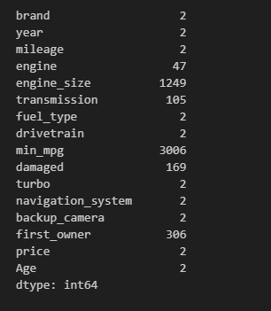
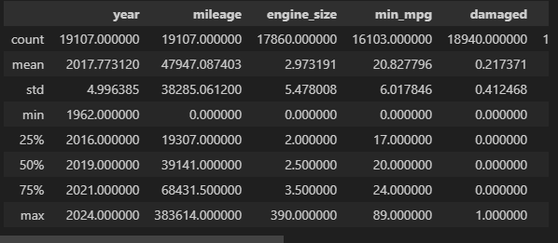
Model Development
Dataset was selected with close to 20000 training rows with 36 columns
15 columns was selected
Features are selected based on the importance of it
General Info
Null values can be seen
Distribution of data seems ok

Slide 5
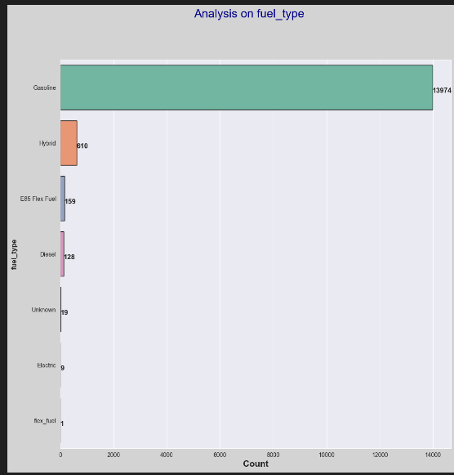
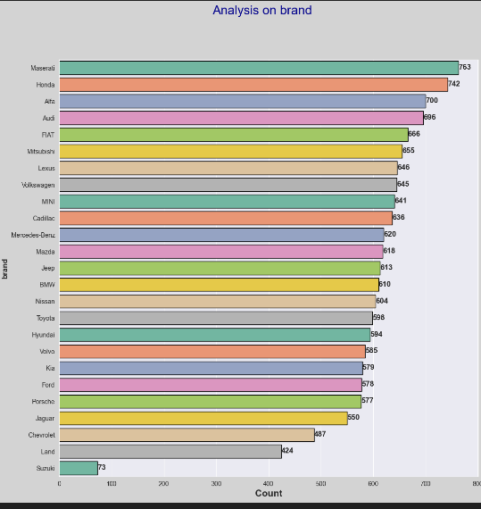
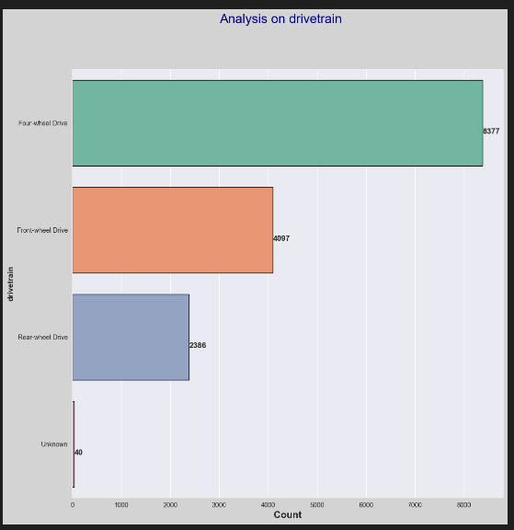
Model Development
Data Preprocessing
Dropping of null values
Imputing may be a viable option but it can result in inaccurate values produced , therefore the best option is to drop the rows
Change the dtype of the price column
Datatype of the price is an object, hence it is required to change the dtype of the price
Exploratory Data Analysis
For brands, we can see that this dataset contains Maserati the most and Suzuki the least
For fuel type, we can see that this dataset contains Gasoline the most and Flex type the least
For fuel drivetrain, we can see that this dataset contains Four Wheel Drive the most and Unknown the least

Slide 6
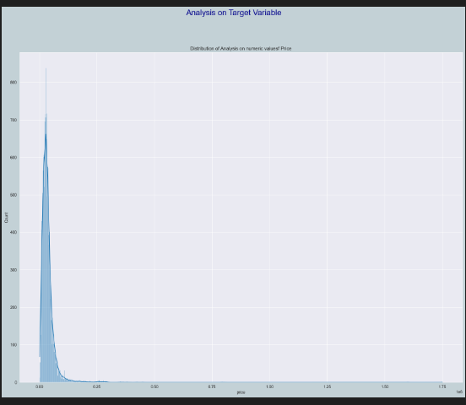
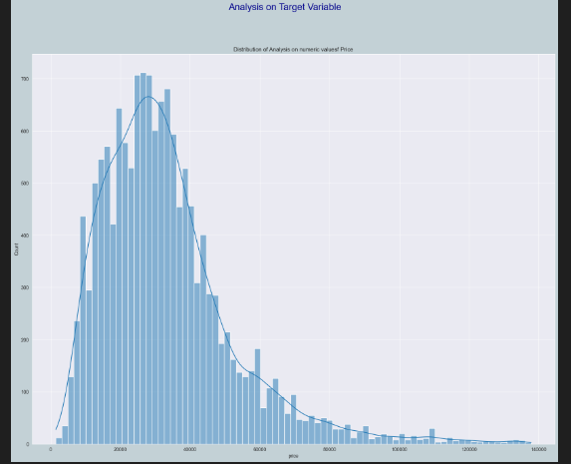
Model Development
Exploratory Data Analysis
For mileage, we can see that this dataset is positively skewed
For engine size, we can see that this dataset pretty symmetrical distribution
Analysis on Target Variable
For the target variable, we can see that the data contains extreme outliers
Data Preprocessing (2)
Extreme outlier was removed

Slide 7
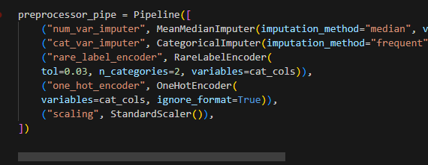
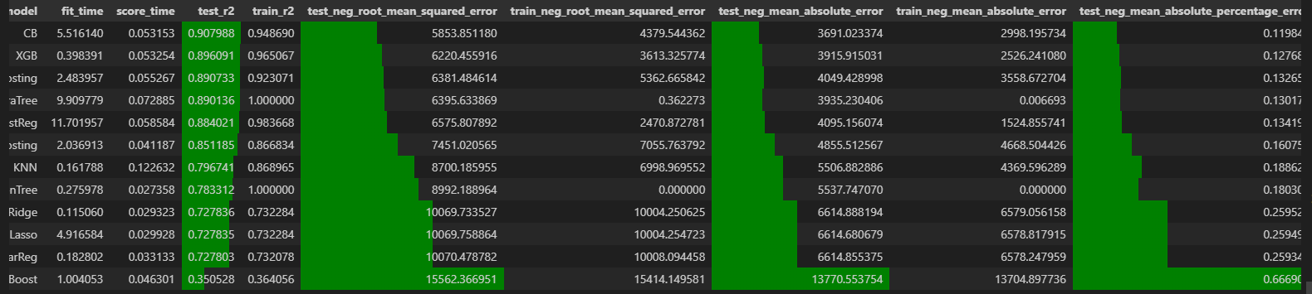
Model Development
Feature Engineering
One Hot Encoder to encode
Age column was feature extracted
Standardisation was done
Model Development (Baseline)
Utilise multiple models
Best model are CatBoost with a r2 score of 0.91
Random forest was also chosen to hyperparameter tune
After Hyperparameter Tuning
Fnal model is Cat Boost Tuned
Pipeline was utilized

Slide 8
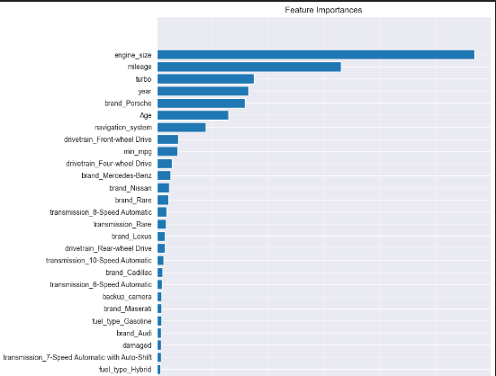
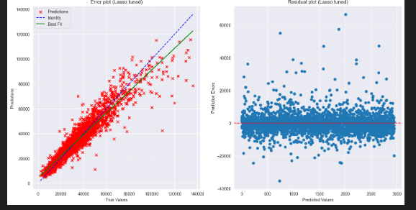
Model Development
Model Predict pretty accurately
Have Engine size as the most important feature

Slide 9
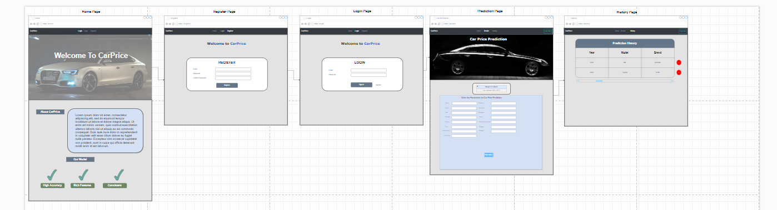
Wireframe

Slide 10
Wireframe
Idea Behind Wireframe
Clean and color on the darker theme
Added photos of cars to showcase the webpage
Having the 5 key pages
Model prediction contains drop down menu
Prediction history store in table form in a single webpage with ability to delete records

Slide 11
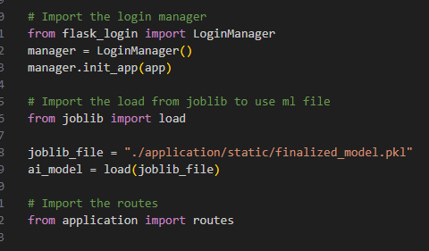
Deploying ML Model
Trained model was loaded
Flask app was utilised together with the trained model

Slide 12
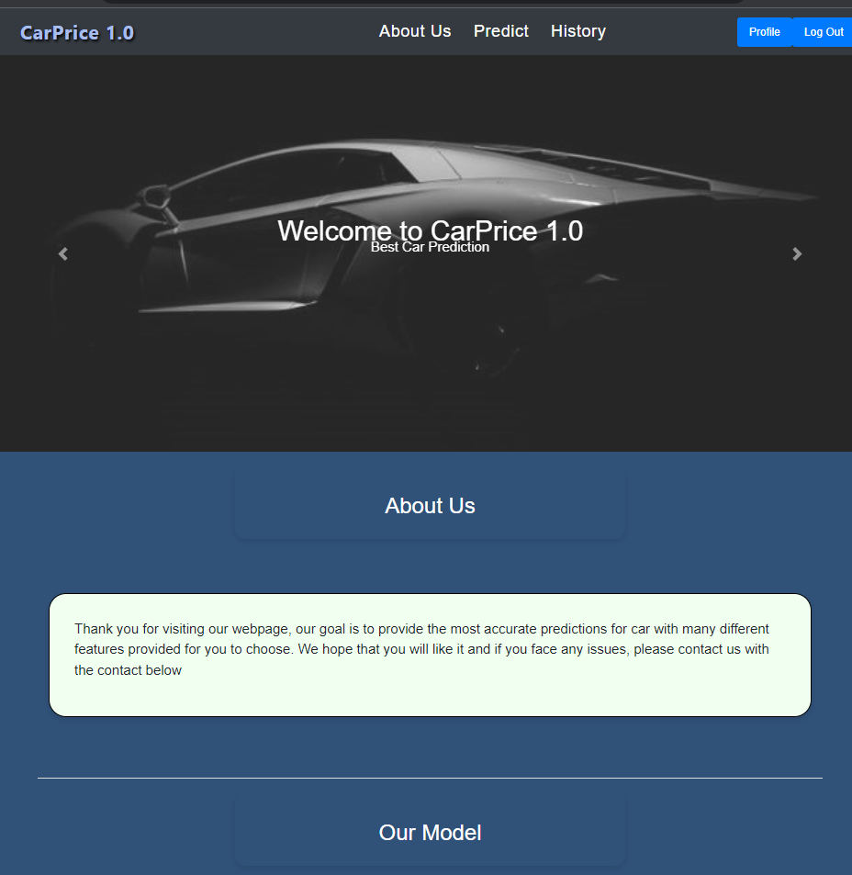
Web Page (Home)
Home page design with the use of cars images
Added an introduction
Provided idea of our model

Slide 13
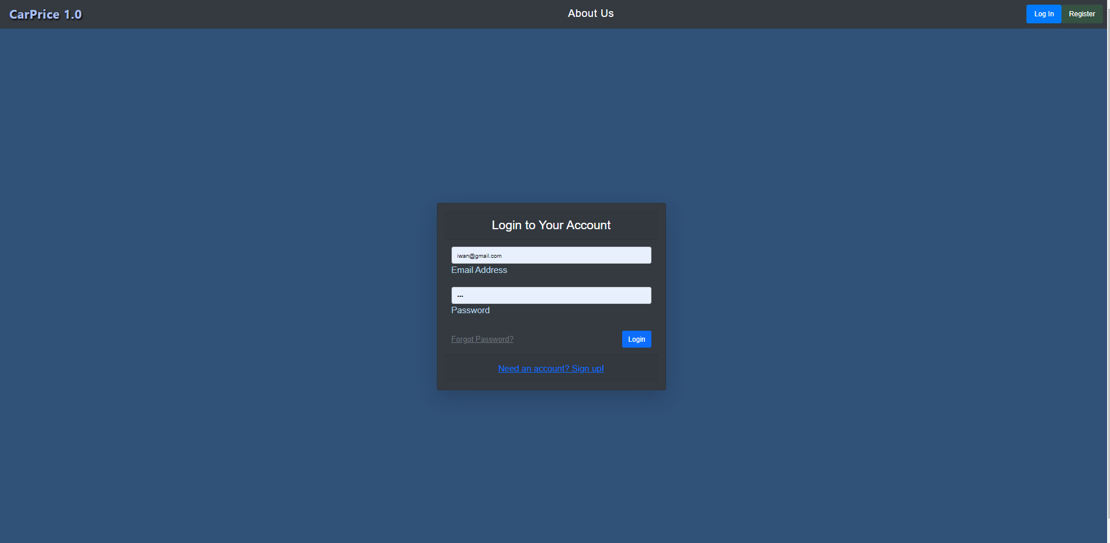
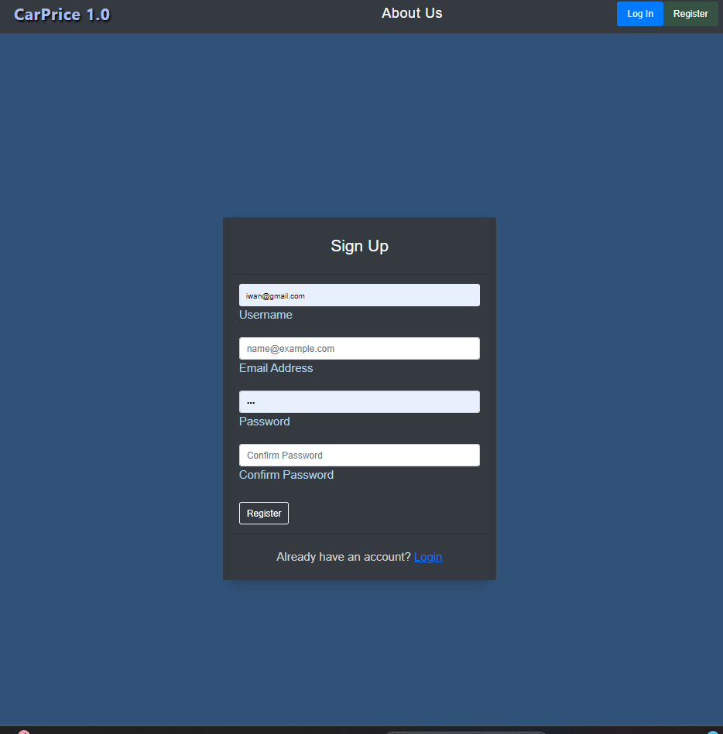
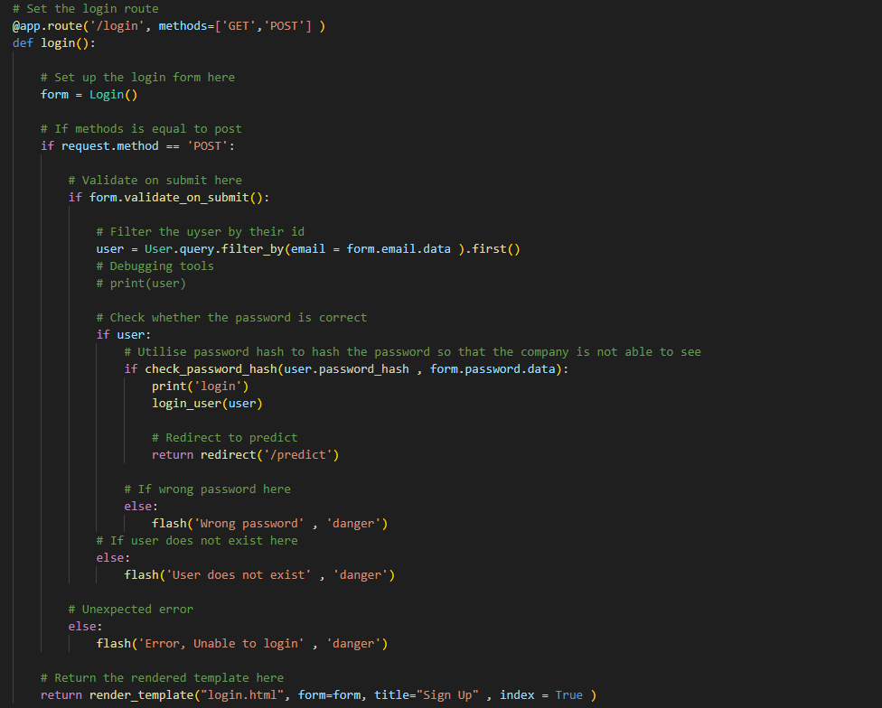
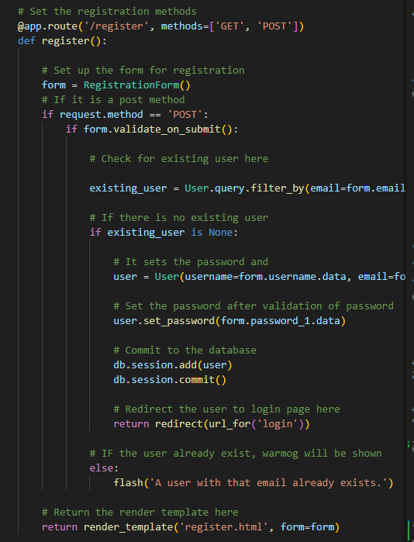
Web Page (Log In and Sign Up)
Login Page provides a clean and responsive look
It provides additional option for password resetting and all
Provides redirecting to register page if user has not log in before
Deployed with flask framework

Slide 14
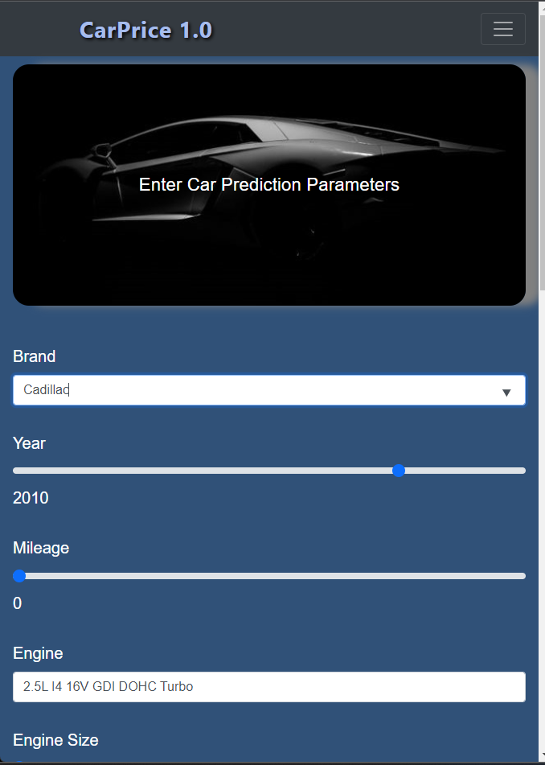
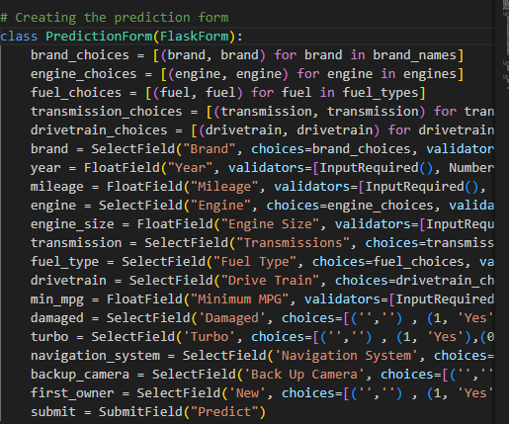
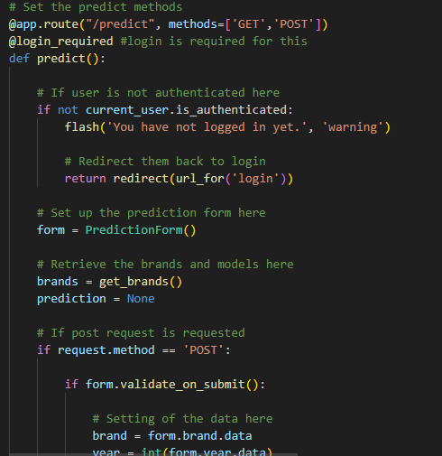
Web Page (Predict)
Provides seamless autocomplete for user input text
Provide slider for numerical value
Provide dropdown menu for multiple options and binary options
Used flask framework

Slide 15
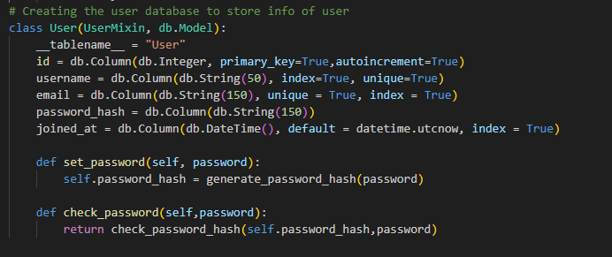
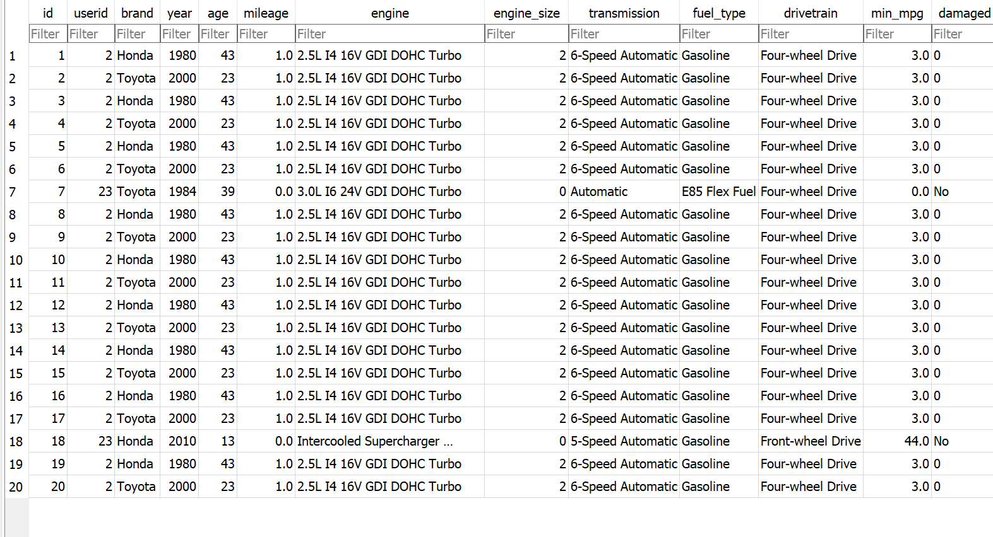
Database
Created the user database in sqlite
Store prediction inside

Slide 16
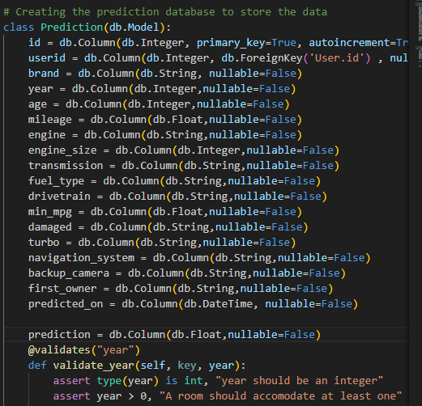
Database
Creation of Prediction Database

Slide 17
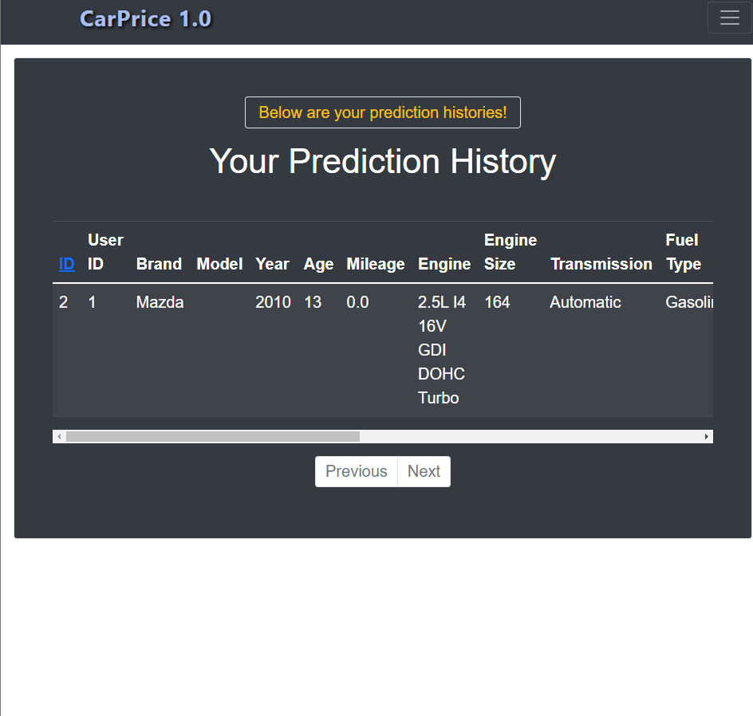
Web Page (Database)
Prediction History was stored
Provide next and back option where each page only show 5 predictions
Allow the deletion of records
Produced with flask

Slide 18
Validity Testing
Test Add Prediction
Provide test for adding prediction
Test Entry
Provide accurate in populating to database
Test Link
Make sure that links are working
Test Client Login Link
Make sure that only client can access this link
Test Prediction
Test prediction with logged in client
Test Registration
Test registration

Slide 19
Range Testing
Test out of range (year)
Check whether it is still able to predict
Test out of range (engine size)
Check if it still able to predict
Test Missing values
Check whether missing or none input
Test Client Login Link
Make sure that only client can access this link
Test negative user id
Check whether negative id is able to login

Slide 20
Expected Failure Testing
Test Missing values
Where there is a missing input
Test invalid credentials
Wrong password for login
Test duplicate records
When user re register with the same email
Consistency Testing
Test Getting multiple prediction with the same perimeter
Check if results are the same

Slide 21
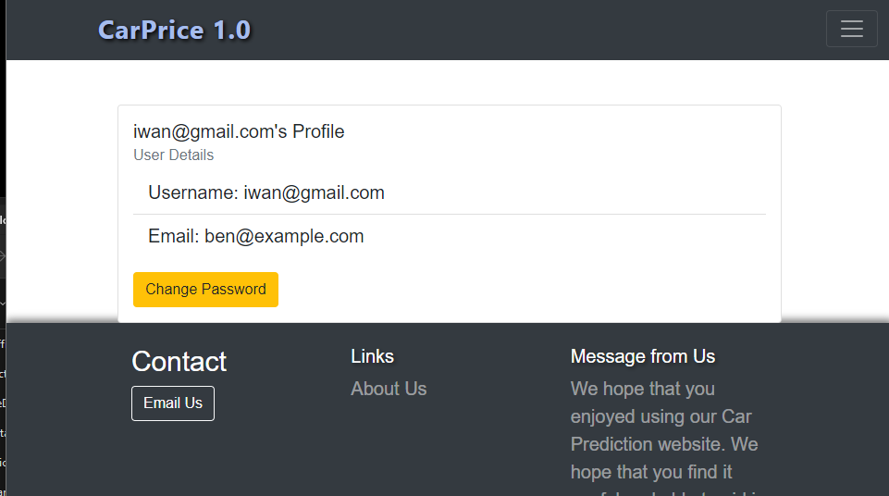
Additional
Created a user profile page that enables the change of password

Slide 22
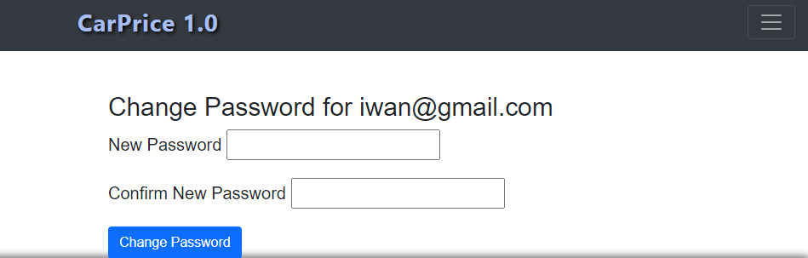
Additional
Provision of change password
Provision of reset password

Slide 23
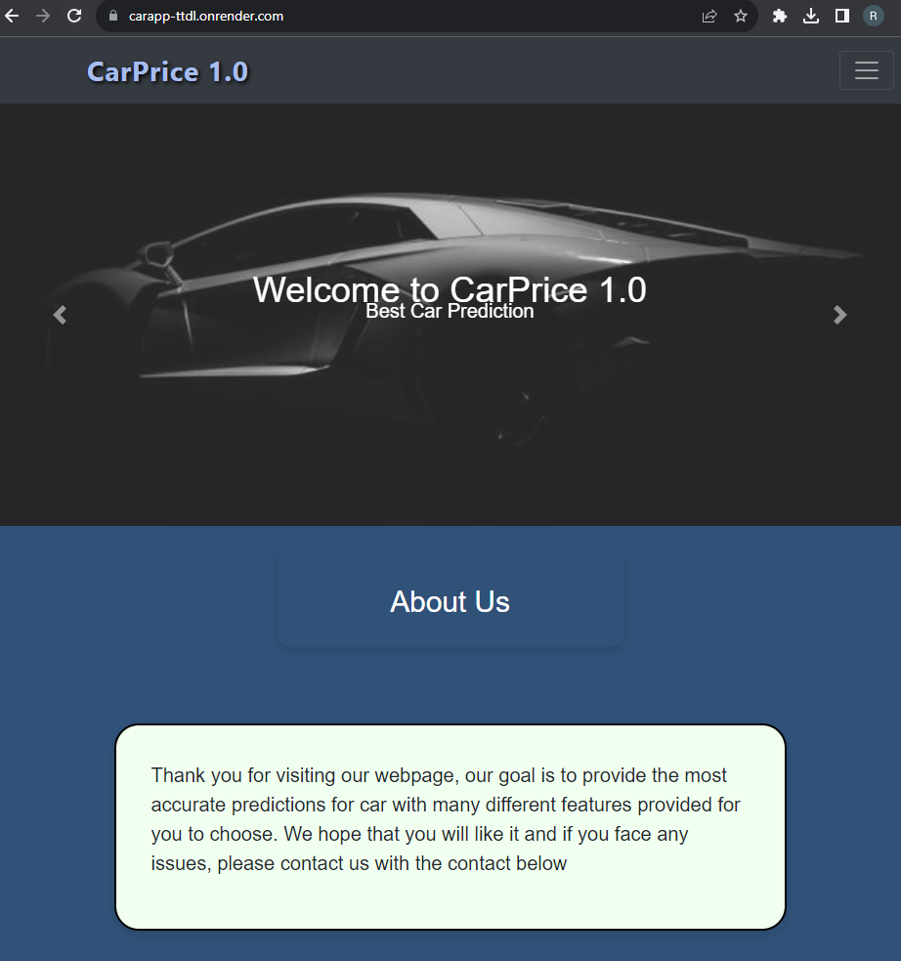

Deployed on Render
https://carapp-ttdl.onrender.com/
https://carapp-ttdl.onrender.com/

Slide 24
Thank You

